Slide 1
DevOps 101 part 1 of 3
Application Economy
Software Development Life Cycle (SDLC)
DevOps History
What is DevOps Defined
A Call to Arms

Slide 2



Application Economy

Slide 3
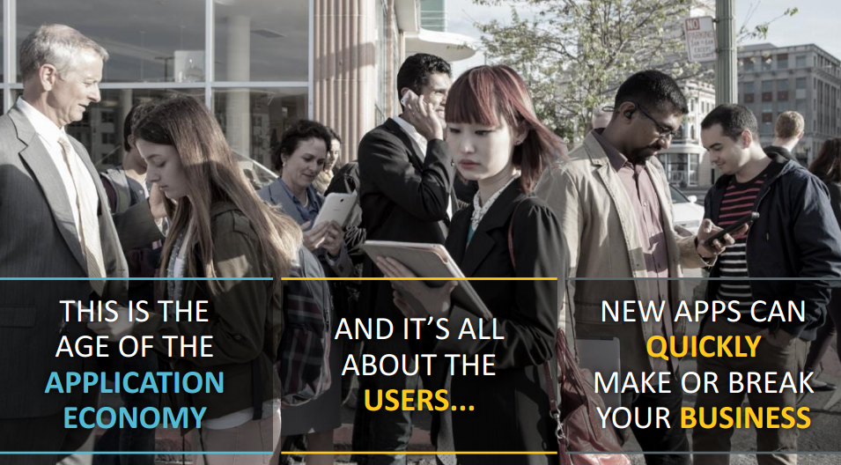
Building a Better Brand

Slide 4
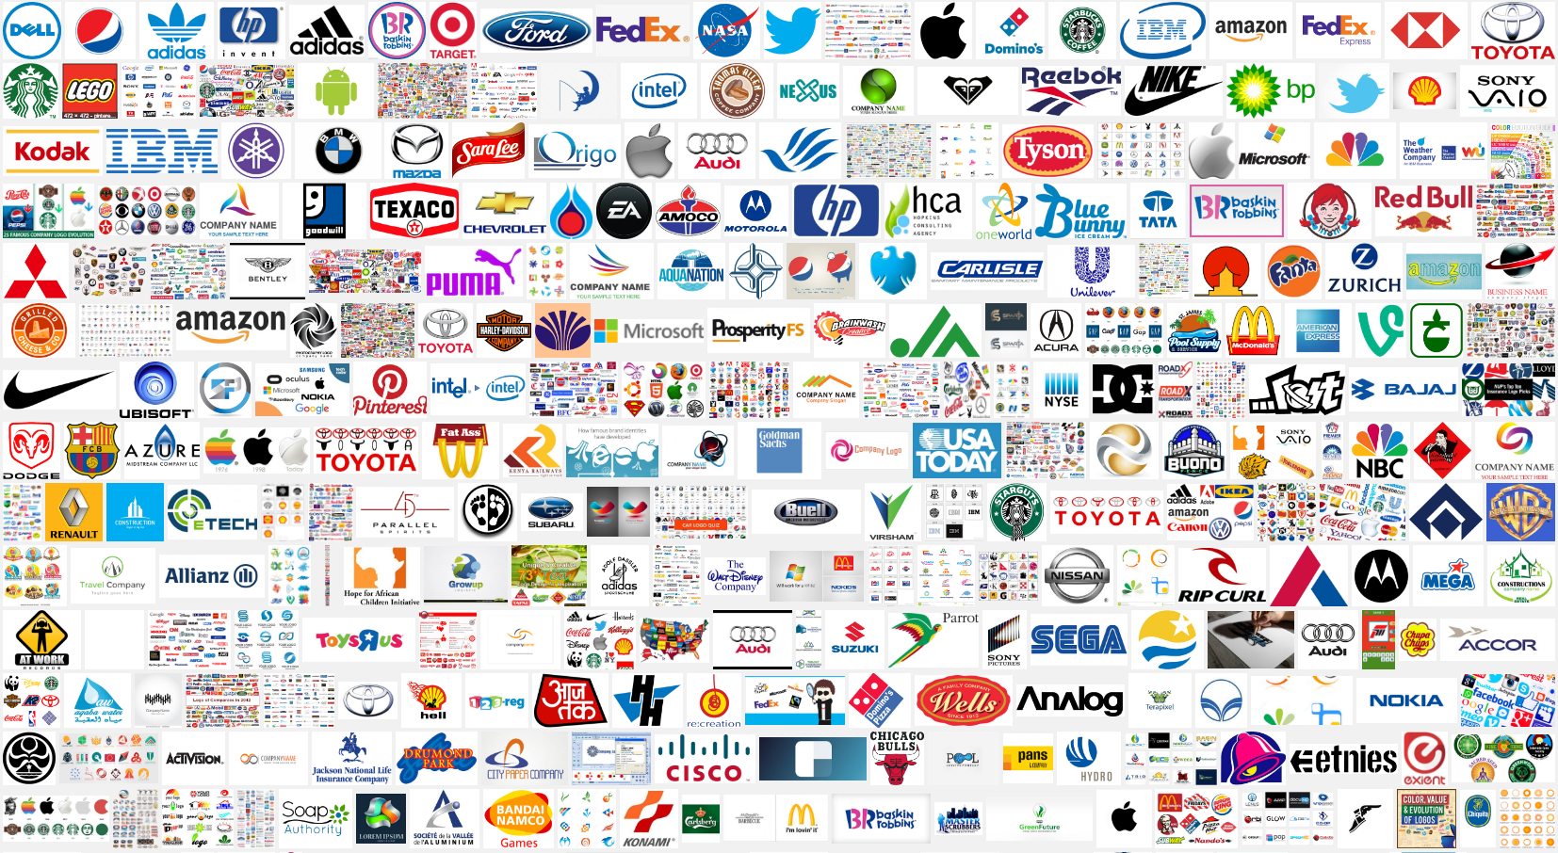

Slide 5
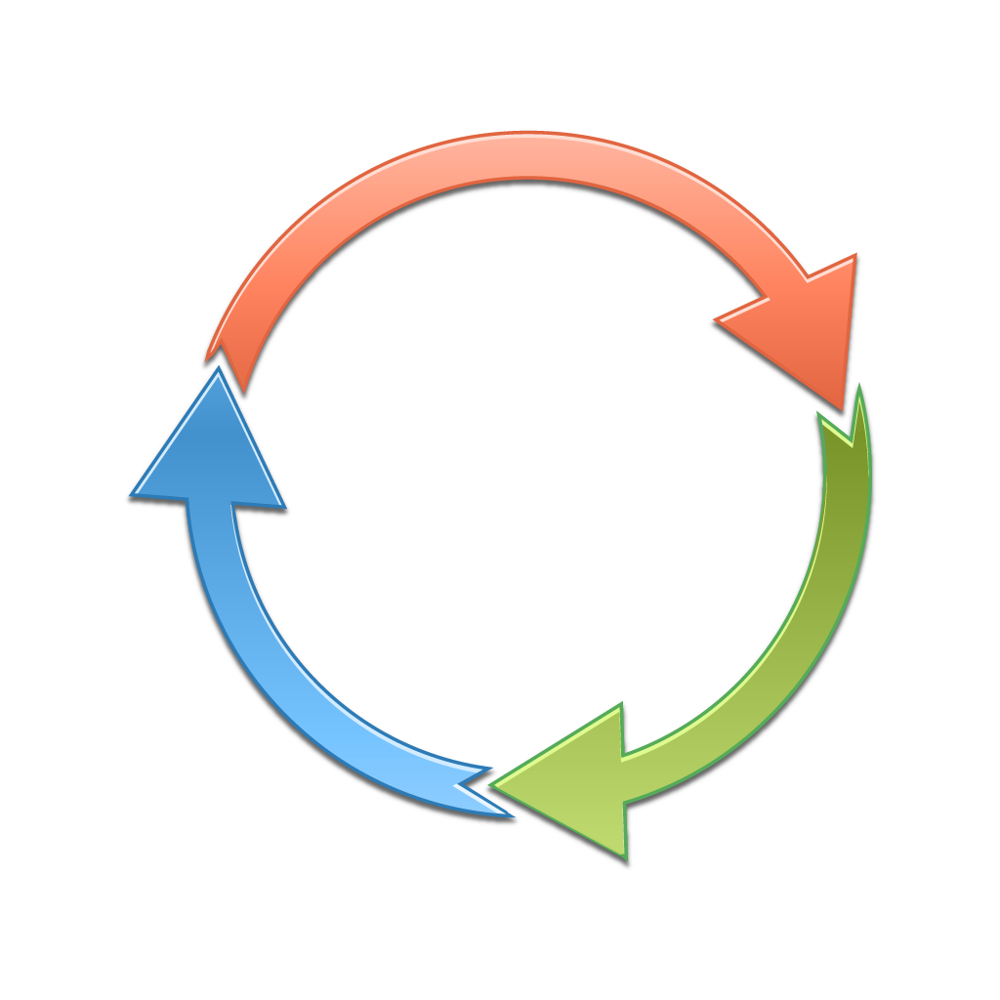
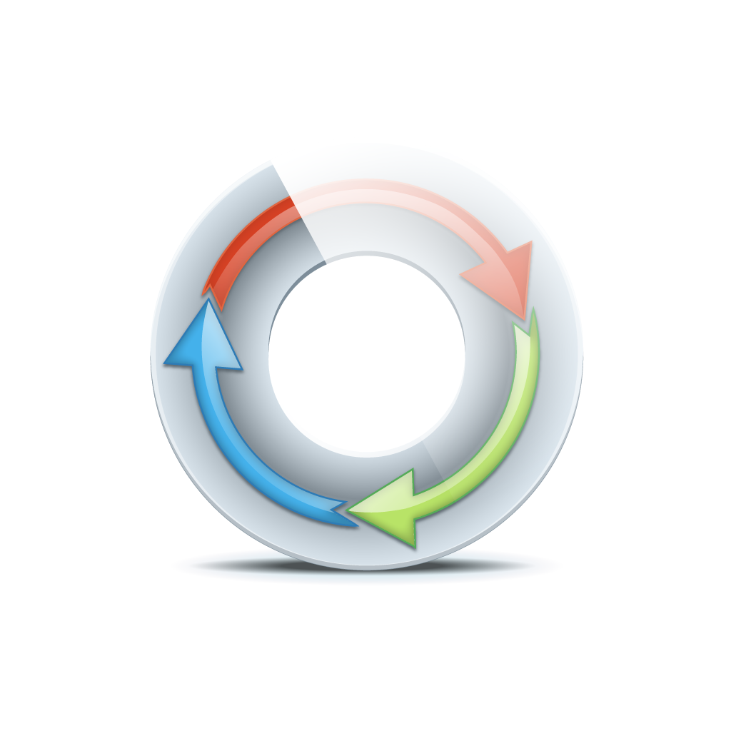


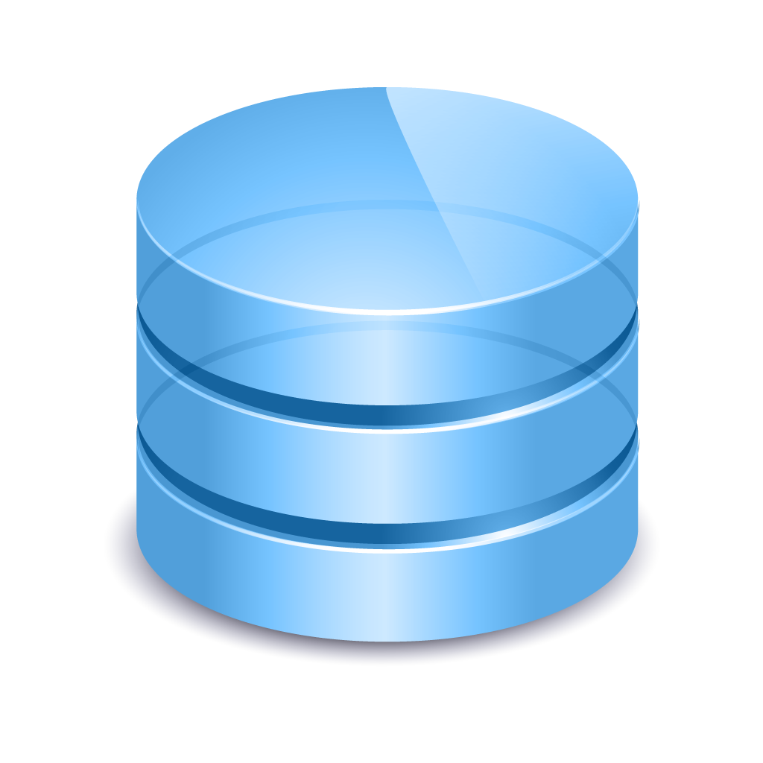
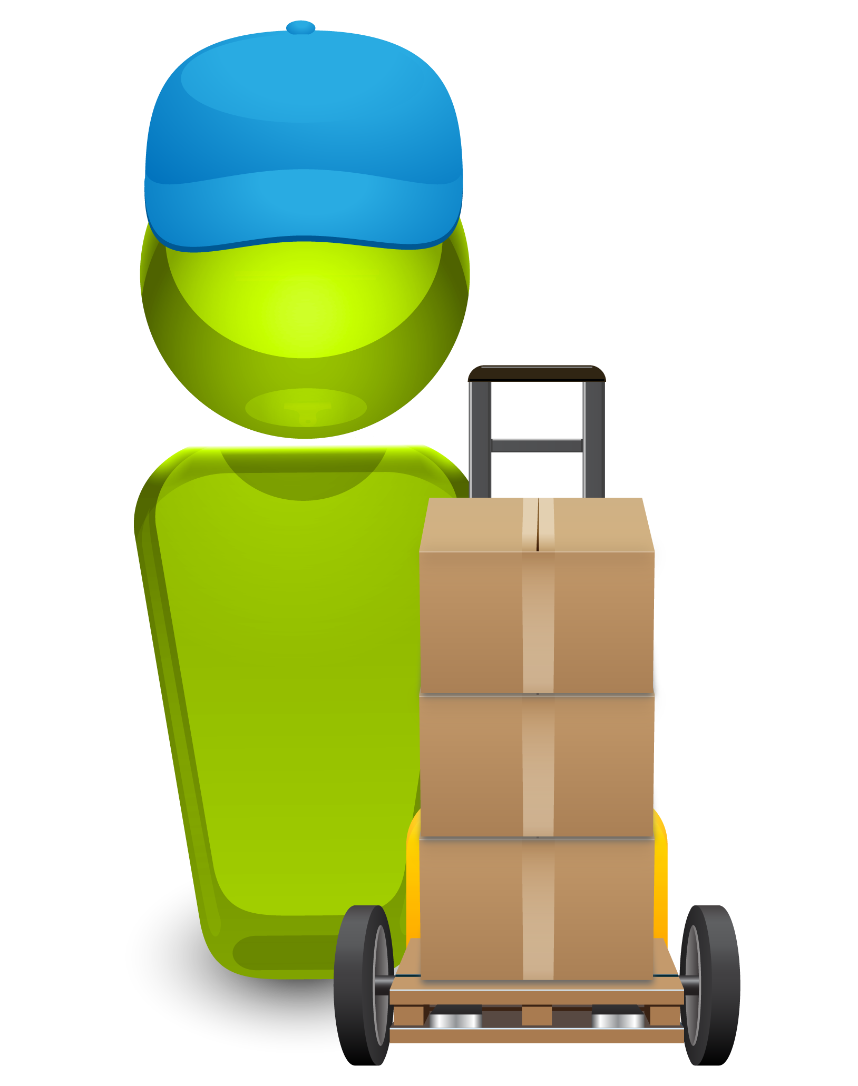
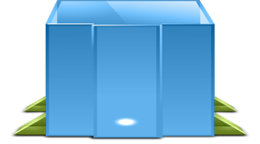
Building a Better Brand
DELIVERED RAPIDLY
HIGH- QUALITY
RESILIENT
DAYS/MINUTES
CONTINUOUS DELIVERY
DEV
INT
UAT
PERF
PROD

Slide 6
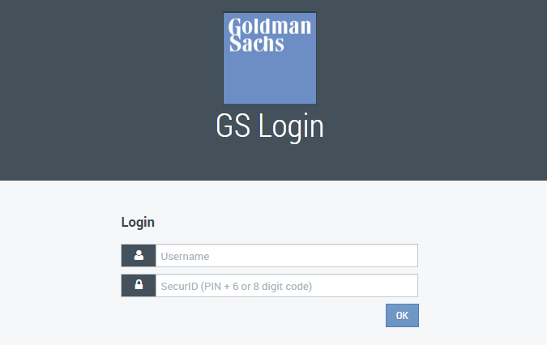
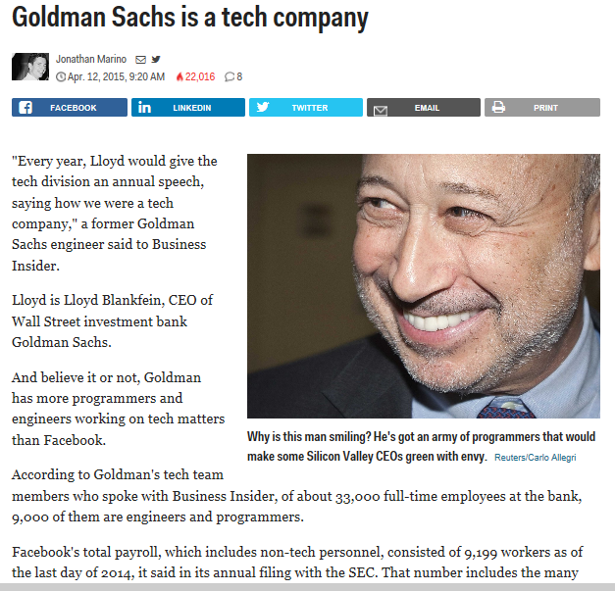
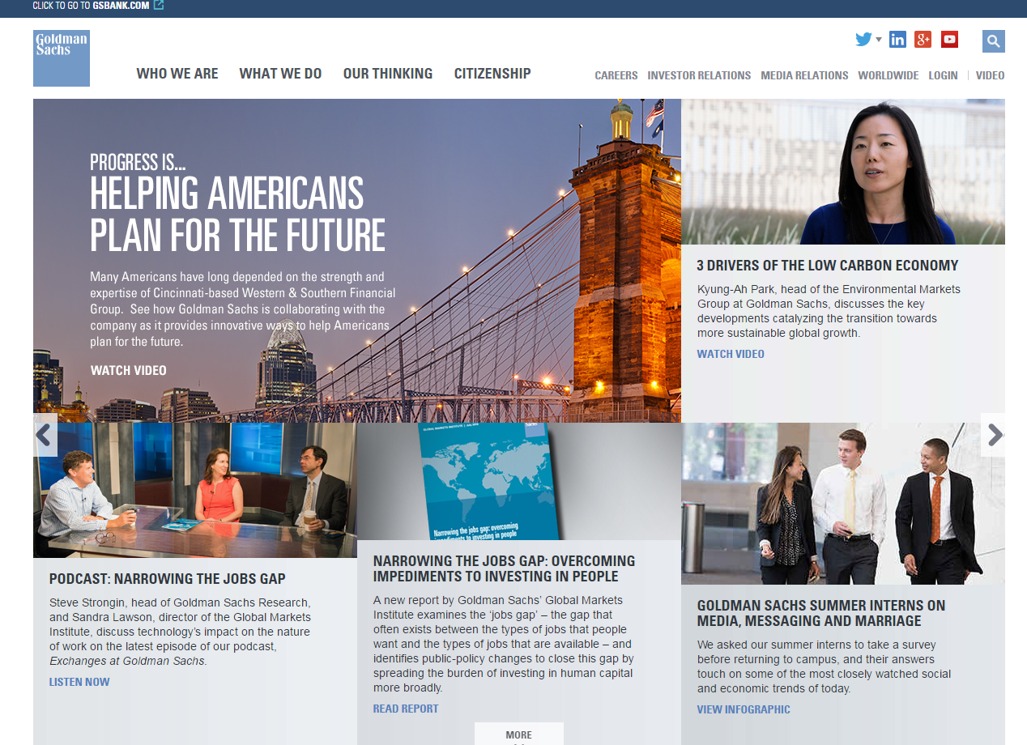

Slide 7


Expectations Are Changing
UNPRECEDENTED SPEED
EXCEPTIONAL CUSTOMER EXPERIENCE
94%
of executives face increased pressure to release apps more quickly
25%
of users will abandon a web application after just three seconds of delay
Notes:
The application economy means new and unprecedented demands for IT organizations and expectations continue to grow. Living up to these expectations is a tremendous struggle for many, and may require updating, revising or replacing infrastructure, app design, service delivery, IT skills, technology assets or even business models.
Customers expect to connect with companies via software for fast easy access to products, services, and information.
If your company isn’t meeting these expectations, your customers are likely to go elsewhere.
In the application economy, external, revenue-generating customers are the most influential stakeholders.

Slide 8
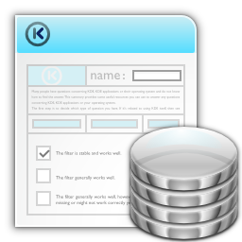


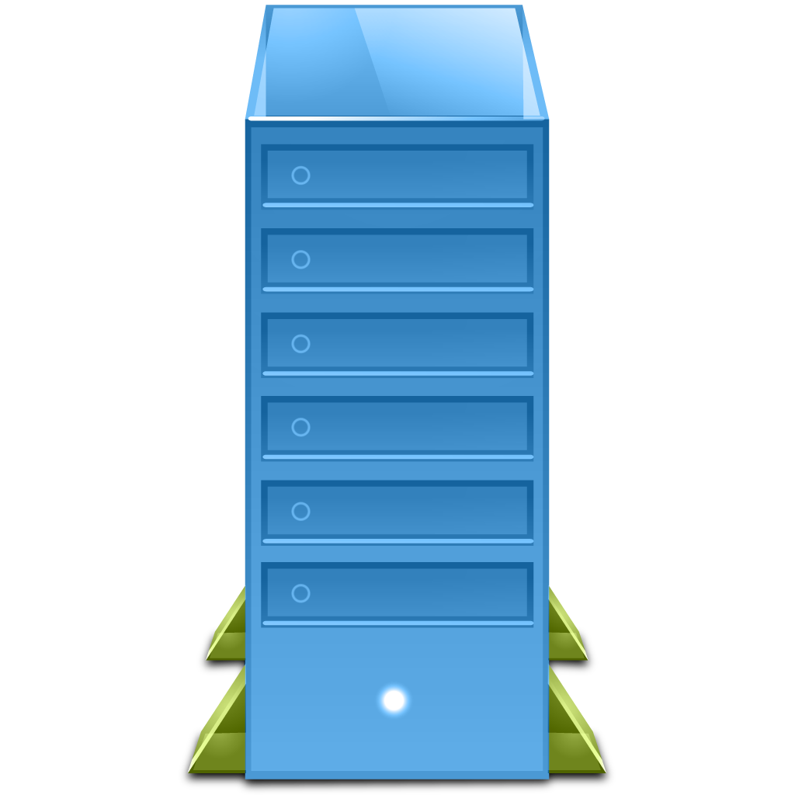
Automating application release operations Enterprise Application Delivery
application
LB
Authentication
Portal
AppServ
WebServ
DB
Engines
Middleware
ESB
OS
artifact
Supplier 1
test
acceptance
production
Supplier 2
Supplier 3
Release Intake
Master Release mgmt
Continuous “zero touch” & standardized
Application Release Deployment

Slide 9


Slide 10

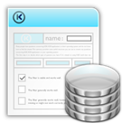


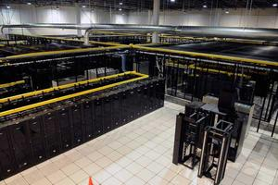
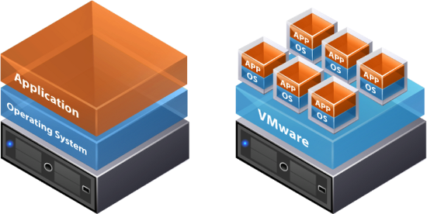
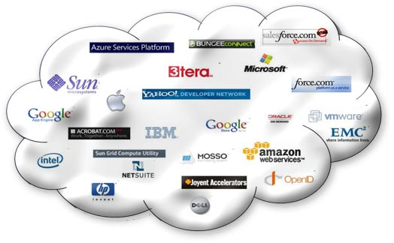
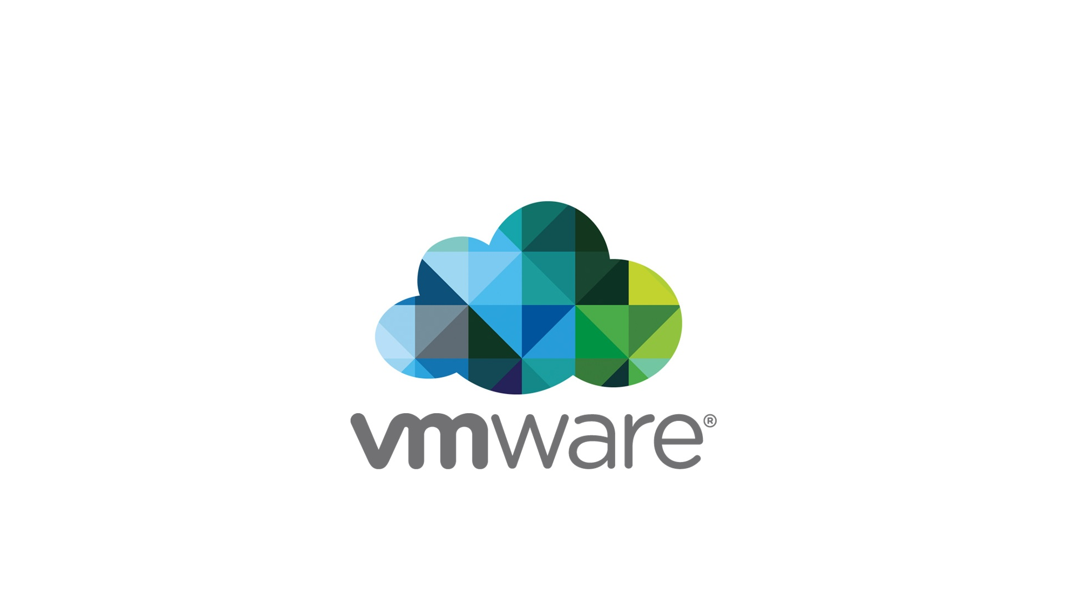

Patrick Debios
The Promise of the digital world
Compliance Rules, Transparency, Regulations, Policies, LAW, Standards, Requirements
Security
Data Management/
Assurance
Network
application
DAYS/MINUTES
CONTINUOUS DELIVERY
Operations guys
Customer
Experience
Business Value
Innovation
DEV
INT
UAT
PERF
PROD
Hybrid-IT

Slide 11



Traditional “Software Factory”
Developers Deadlocked
Constrained Environments
Manual
Testing
Too little testing, too late in the cycle
Too many disparate tools
Manual
Scripting
Poor customer experience
Customer
Experience
Work Time
Wait Time
IDLE TIME
SCM
DELAYS
TEST
DELAYS
DELAYS
IDE
CI
CONTAINER
CONFIG
CLOUD
PROVISION
Code | Integrate | Build
defect
Functional & UA Testing
defect
Performance Testing
defect
Deploy to Production
DEV
QA/TEST
PRE-PROD
PRODUCTION
RE-WORK
RE-WORK
RE-WORK
SLOW AND INEFFICIENT - EXCESSIVE IDLE TIME, DELAYS AND RE-WORK
Notes:
Nearly every organization today is struggling to deliver what the business needs, when the business needs it. The traditional “software factory” or process for transforming an idea a customer experience is throttled by a number of bottlenecks in the delivery pipeline.
<build 1> Different development teams typically work on different interdependent parts of the app, so dev teams often sit idle waiting for other components to be completed.
<build 2> As development teams crank out multiple CI builds every day, these builds also need to be tested and validated so that they can move through the pipeline. Manually creating and configuring the necessary environments takes a lot of time and effort, creating a bottleneck in the process.
<build 3> Constrained environments can force difficult decisions, rather than delay the project, teams are often forced to move forward anyway, delaying testing until the end of the cycle, when errors and defects require significantly more re-work than if they’re found early in the cycle. Test environments are rarely provisioned with the necessary test data to create a real-world ‘production-like’ environment. So even when the environments are available, they may not yield the most accurate results and testing is done manually, which means further delays.
<build 4> There are multiple teams involved in the delivery process – dev, test, release management, operations – and each has their own set favorite tools they use to perform their tasks. These tools are constantly changing and new ones emerge on a regular basis.
Dev teams may use SCM tools like Git or TFS for file management and version control and Continuous Integration (CI) servers like Jenkins or Team Foundation Server (TFS) to monitor the SCM for changes and then launch the build process, as well as Nexus or Artifactory as a repository for managing artifacts. Some advanced development teams are using container tools, like Docker to package code for quick assembly and hand-off.
QA/Test teams use a variety of different testing tools to manage test data or to automate some aspects of testing.
Release Management or ops teams use configuration tools like Chef and Puppet, and many use cloud management tools and/or provisioning tools.
<build 5> These different tools don’t just automatically work together, so orchestrating all of the interdependent functions and writing manual scripts to manage how the tools interact, may actually take more time than they are meant to save.
<build 6> Time-to-market isn’t the only thing that is impacted by all this inefficiency – when errors or defects aren’t discovered until after an app is deployed to production, customer experience suffers, potentially damaging your brand.

Slide 12




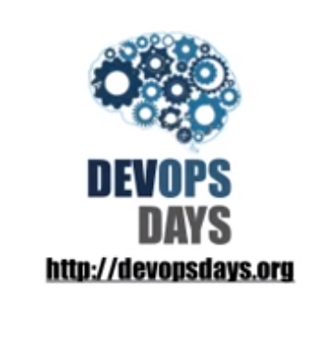

Slide 13

What are Challenges that Companies are Experiencing?
DEVELOPMENT
OPERATIONS
SPEED
STABILITY
Customer
Experience
Agile, Lean
ITIL, process, SLA’s
Bring features/products to market faster
Ensure availability; MTBF
Cloud, open source, infrastructure-as-code
Legacy and proprietary apps/infrastructure
Notes:
But most organizations are not as progressive as Amazon or Facebook. In any organization with a separate operations department, and especially those with an independent QA or testing function…most of the pain in getting software delivered is caused by poor communication between these groups, exacerbated by a cultural divide and conflicting goals. Dev teams are measured on speed and throughput, and ops teams are measured according to stability. Testing and release management teams are often caught in the crossfire between dev and ops teams.
Ultimately, everyone is trying to accomplish the same goal, to create business value through software - but everyone needs to get better at working together toward this goal rather than trying to optimize our own domain.

Slide 14









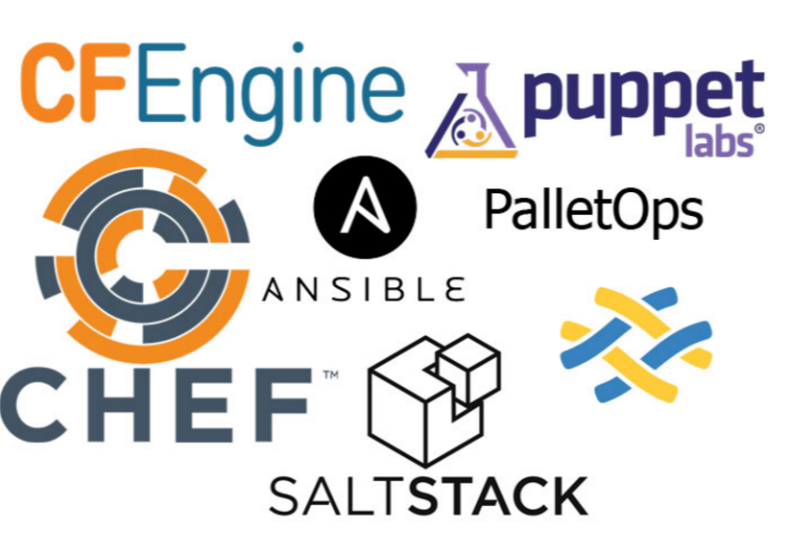
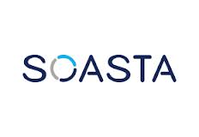

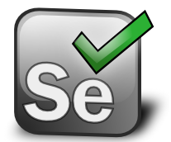




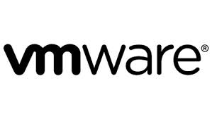
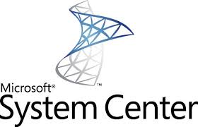
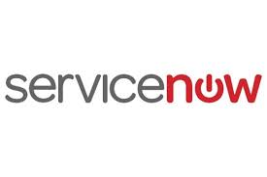
DevOps Tools
ARTIFACT REPOSITORY
CONTINUOUS INTEGRATION
BUILD AUTOMATION
TEST AUTOMATION
CONFIGURATION MANAGEMENT
Application Model
Environment Data
CHANGE MANAGEMENT
INFRA PROVISIONING
SDLC
Release Data
INT
UAT
PERF
PROD

Slide 15


Slide 16
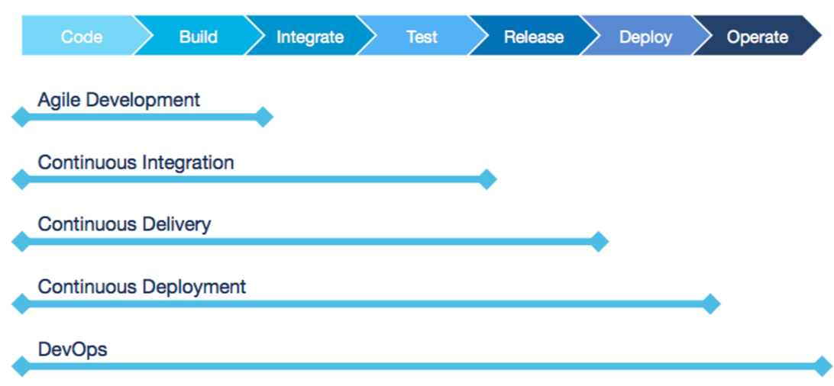

Slide 17

DEV
OPS
Communicate
Integrate
Collaborate

Slide 18

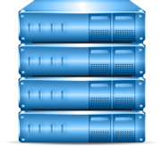



The Challenge of Today’s Complex and Dynamic IT Environment
LACK OF API TESTING (too many bugs escape downstream)
LACK OF AUTOMATED TESTING (small changes could have major unintended consequences)
LACK OF VISIBILITY INTO PROD. APPS (no visibility into the customer experience)
Code
Commit
Developer 1
Developer
Branch SCM
Operations
Code
Commit
CI Server
deploy
deploy
deploy
deploy
Developer 2
Developer
Branch SCM
Integration Lab
UAT/Staging
Environment
Production
Performance Lab
Code
Commit
LACK OF RELEASE AND ENVIRONMENT AUTOMATION (manual processes lead to poor release quality)
Developer n
Developer
Branch SCM
CI Server
Notes:
Put gear on each place we’re doing promotions

Slide 19
What are Challenges that Companies are Experiencing?
DEVELOPMENT
OPERATIONS
SPEED
STABILITY
Customer
Experience
Agile, Lean
ITIL, process, SLA’s
Bring features/products to market faster
Ensure availability; MTBF
Cloud, open source, infrastructure-as-code
Legacy and proprietary apps/infrastructure

Slide 20
http://www.businessinsider.com/goldman-sachs-has-more-engineers-than-facebook-2015-4
https://www.youtube.com/watch?v=8NPzLBSBzPI

Slide 21
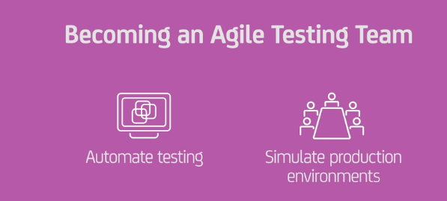
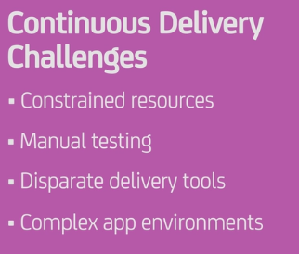
THE PROBLEM DevOps -Automating the Software Development Life Cycle (SDLC)
CONTINUOUS VALIDATION
Code
Commit
Developer 1
Developer
Branch SCM
Code
Commit
CI Server
deploy
deploy
deploy
deploy
Developer 2
Developer
Branch SCM
Integration Lab
UAT/Staging
Environment
Production
Operations
Performance Lab
Code
Commit
DATA
MINING
CONTINUOUS DELIVERY
Developer n
Developer
Branch SCM
CI Server
TRUE AGILE DEVELOPMENT
Notes:
Disparate environments
Test data not equal to production data
Custom Manual testing scripts

Slide 22
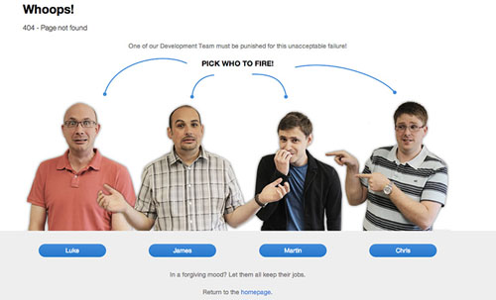

Slide 23
So , What is DevOps ?

Slide 24










So , What is DevOps ?
Continuous Delivery REDEFINED
Culture
Technology
Tools
Process
Customer
Experience
Application Pipeline
Parallel
Work
Streams
Quality
Acceleration
End-to-end Automation

Slide 25




Culture
Development Team
Operations Team
Communicate
Collaborate
Integrate
Understand

Slide 26

Processes
CONTINUOUS DELIVERY
Bring Software to market continuously..
Eliminate friction points
Align to business Objectives
ENVIRONMENTS DATA
APPLICATION MODEL
RELEASE DATA
SDLC
Manifest
Manifest
Manifest
Manifest
QA
UAT
PERF
PROD
PROMOTE
PROMOTE
PROMOTE
Notes:
Release data: artifacts for release, release type (full, partial, hot fix), rollback logic, application config
Show same set of environments as other slides

Slide 27
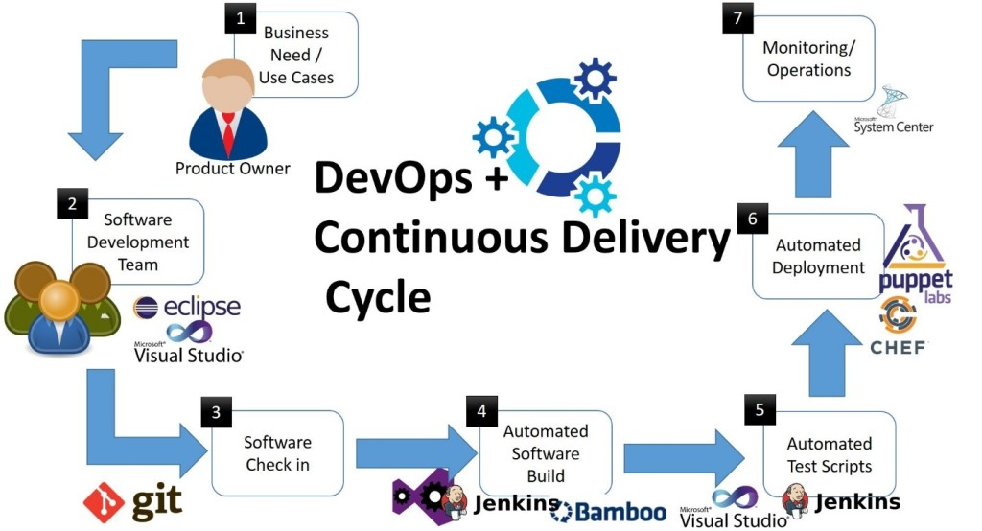

Slide 28

https://www.youtube.com/watch?v=fGaVFRzTTP4

Slide 29
MONTHS
Software Development Life Cycle
DEV
PROD
DEV
QA
UAT
PERF
PROD
Innovation
PROD
Business Value

Slide 30


Identifying the problem
MORE INNOVATION, QUICKER, LESS COST
Agile Development
Test Automation
Continuous Integration
Virtualization/Cloud
Provisioning Automation
Configuration Mgmt
50%
Release Errors
Long Time To Market
High Costs
Innovation
DEV
INT
UAT
PERF
PROD
Business Value
MONTHS
DAYS/MINUTES
CONTINUOUS DELIVERY
Notes:
Use previous environment pics…redo
This slide discusses the state of many development and IT operations organizations today.
We start off talking about Innovation. A lot of innovation is happening on the development side. Development can create new applications and features faster than organizations can get them to production where they create real business value.
Many development teams have implemented Agile methodologies, automated testing and Continuous Integrations systems to help speed up development and unit test cycels and reduce bottlenecks on the dev side.
It Ops have implemented virtualization, cloud and infrastructure and configuration automation technologies to help speed up the provisioning of infrastructure components.
According to Gartner more than 80% of all mission-critical IT service outages result from people and process errors and failures, and of those outages, more than 50% result from a lack of coordination between change, release and configuration management processes.
All which result in delayed time-to-more and increased costs.
A Continuous Delivery solution that automates the release and deployment processes and eliminate in-house written scripts and manual processes can significantly improve the speed and quality in which applications are delivered across the entire application lifecycle – development through production.

Slide 31



DevOps is not just about Increasing # of Releases It is about Accelerating Throughput… Speed with Quality!
ACCELERATE DELIVERY
New applications
Changes to existing apps
Bug fixes
INCREASE RELIABILITY
Software is the customer experience
Quality and Performance are critical
MANAGE COMPLEXITY
Composite services and heterogeneous systems
Reduced budgets
Distributed development teams and IT partners

Slide 32
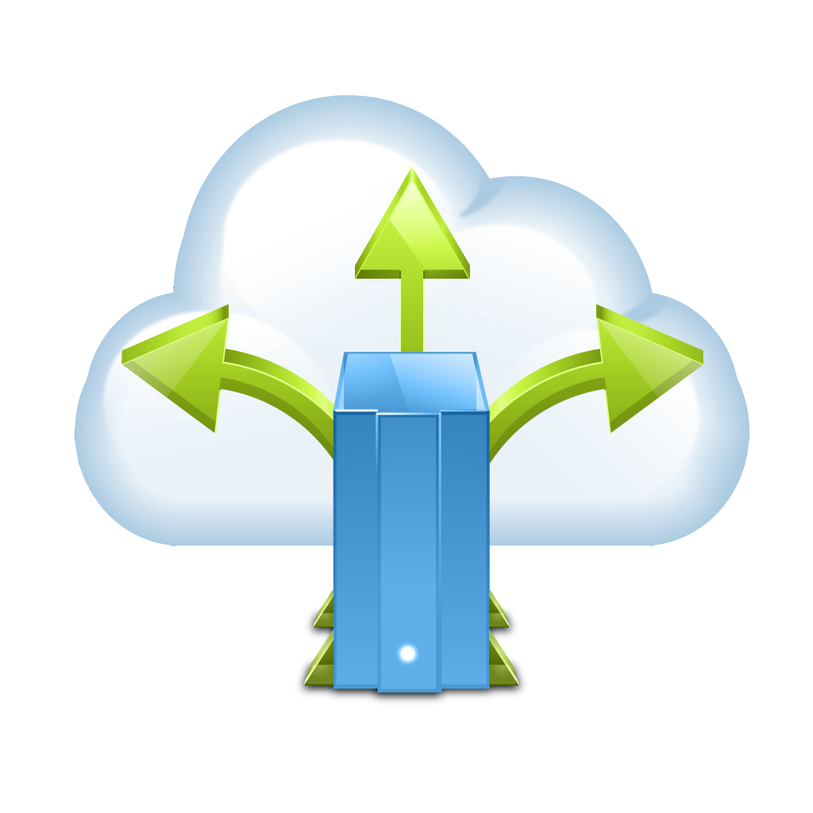
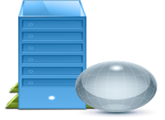
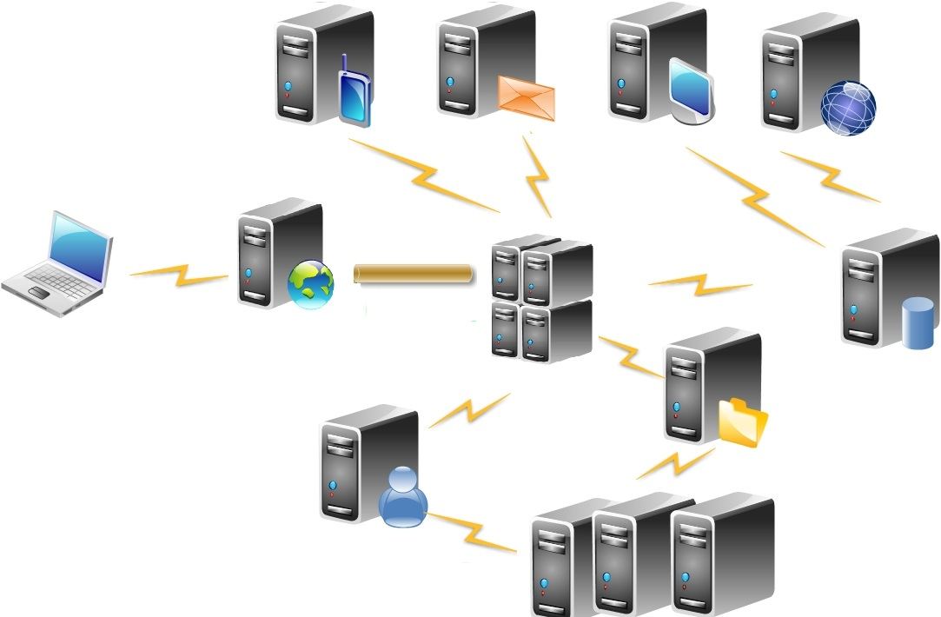
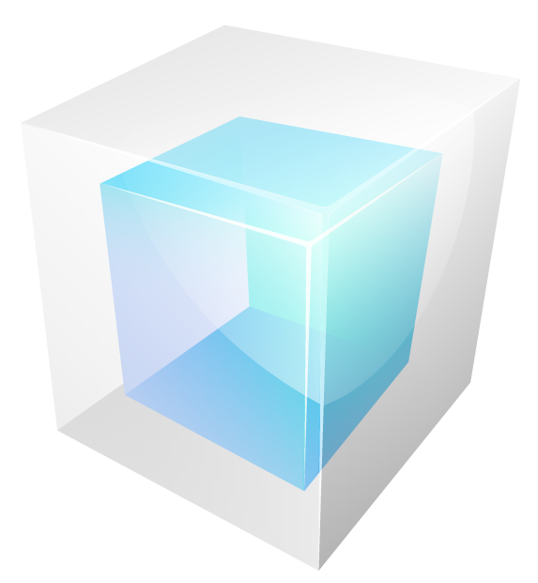

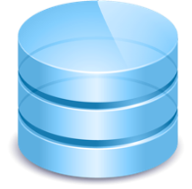


What is DevOps?
Technology
Communication
Collaboration
Integrating
Understanding
Culture
Environment Resources
Environment Configuration
Processes
Development Operations
coming together
DevOps
Application
Artifacts
Release
Type
Application
Configuration
Notes:
Release data: artifacts for release, release type (full, partial, hot fix), rollback logic, application config
Show same set of environments as other slides

Slide 33

Elevator Pitch
Verizon helps organizations orchestrate the entire application release process and automate the deployment of applications from development into production.
Application deployment tasks are automated, errors are reduced, software releases are more reliable, and throughput is dramatically improved.
Speed up application release cycles and improve business and operational agility
Reduce errors and achieve higher quality releases by simplifying and standardizing application release processes
Enable more frequent releases and reduce risk of failure
Reduce costs of application deployments and promote collaboration and alignment between Development and Operations
Improve visibility across the entire deployment tool chain

Slide 34
Customer Champions & Stakeholders
VP DEVELOPMENT/ APPS AND ENTERPRISE ARCHITECTS
VP OPERATIONS, DEVOPS/RELEASE MANAGER
LINE OF BUSINESS OWNER (LBO)
Driven by meeting/exceeding project goals; faster time to market; meeting/exceeding quality metrics
Driven by meeting/exceeding deployment goals; increasing productivity; improving operational efficiencies
Driven by accelerating time to market; meeting business/financial metrics; reducing risk & cost; business enablement

Slide 35
How long does it take to release an application?
What are the most challenging aspects of your application deployment process today?
Please describe your overall change and release processes.
What strategic initiatives are driving the demand for increased business and operational agility?
What are your current release times or frequency of development/test/stage/production deployments?
How do you run your application deployments today? How much of that are manual or scripts based?

Slide 36
Product Matrix
Competitor | Strengths | Weaknesses | How to beat
IBM UrbanCode Release & Deploy | Ease of use Integrations/Plug-ins Roots in development with build management | Easy but rigid deployment model No Manifest Driven deployment Limited workflow functionality | Stress Manifest Driven capabilities Leverage strength of Create FUD of IBM Vendor lock-in Leverage Full Application Delivery Solution
Automic (UC4) | Mature Automation Backend WA Customer Base Configuration Management Solution for SAP | Mature Automation Backend WA Customer Base Configuration Management Solution for SAP | Stress graphical workflow engine – no scripting Manifest capabilities – reusable processes CA Cloud Manager for environment management
XebiaLabs DeployIT | Good presence in dev community Stresses agentless technology as an advantage | Agentless implementation is less secure, less scalable Small company, immature product | Stress graphical workflow engine – no scripting Manifest capabilities – reusable processes CA Cloud Manager for environment management
BMC Application Management Suite | WebSphere/WebLogic Actions Management layer for provisioning, cloud management, ITSM | Release Automation done through scripting Lack of focus Separate products/complicated implementation | Stress graphical workflow engine – no scripting Manifest capabilities – reusable processes CA Cloud Manager for environment management
STRENGTHS
WEAKNESSES
HOW TO BEAT

Slide 37
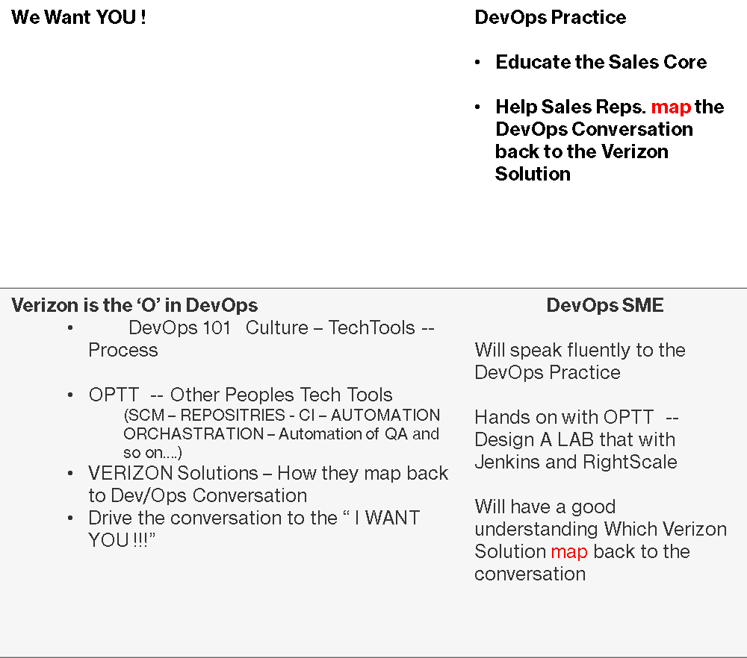

DevOps Team
37

Slide 38







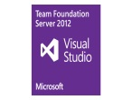








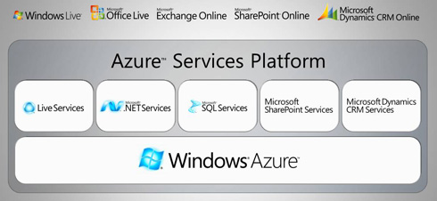


Application Factory
Integrate open source and 3rd party tools
Automate application deployment & promotion
Create continuous feedback loops
Which Verizon Solutions map to the Application Factory?
How do these Application Accelerate App Delivery, make resilient an automate the process?
ICC -- SCI – ACTIFIO – NetApp – IPsoft – What else?
Document requirements
Design Spec
Customer
Experience
Plan Release
REP MGR
SCM
CI
CONTAINER
TEST
CONFIG
CLOUD
PROVISION
Code commit
SCM
CI/Build
Integration testing
Functional testing
UAT
Deploy to pre-prod
Performance testing
Deploy to production
DEV
QA/Test
PRE-PROD
release alert & details
PRODUCTION
APM

Slide 39
Map the Verizon solution with the SDLC
Application Factory
Integrate open source and 3rd party tools
Automate application deployment & promotion
Create continuous feedback loops
Which Verizon Solutions map to the Application Factory?
How do these Application Accelerate App Delivery, make resilient an automate the process?
ICC -- SCI – ACTIFIO – NetApp – IPsoft – What else?
Document requirements
Design Spec
Customer
Experience
Plan Release
REP MGR
SCM
CI
CONTAINER
TEST
CONFIG
CLOUD
PROVISION
Code commit
SCM
CI/Build
Integration testing
Functional testing
UAT
Deploy to pre-prod
Performance testing
Deploy to production
DEV
QA/Test
PRE-PROD
release alert & details
PRODUCTION
APM

Slide 40
This is the yellow option for the alternate section header.
Supporting text goes here. Use this text level as a lead-in or summary paragraph. Use the “Increase List Level” and “Decrease List Level” buttons in the “Paragraph” section of the Home tab to change text levels.
Additional text levels are possible, like this.

Slide 41
This is the orange option for the alternate section header.
Supporting text goes here. Use this text level as a lead-in or summary paragraph. Use the “Increase List Level” and “Decrease List Level” buttons in the “Paragraph” section of the Home tab to change text levels.
Additional text levels are possible, like this.

